Slide 1


CSB4301 – Theory of Computation
B.Tech – IVth Semester
Mr. D.S.John Deva Prasanna AP(SG) & Ms.Vanathi, AP,CSE
Department of Computer Science and Engineering

Slide 2
DFA – Transition Funtion Vs Extended Transition Function
Transition Function : A transition function takes a state and an input symbol as input and returns a state as output.
Extended Transition Function : A extended transition function takes a string of symbols(one or more) and a state as input and will return a state as output.

Slide 3
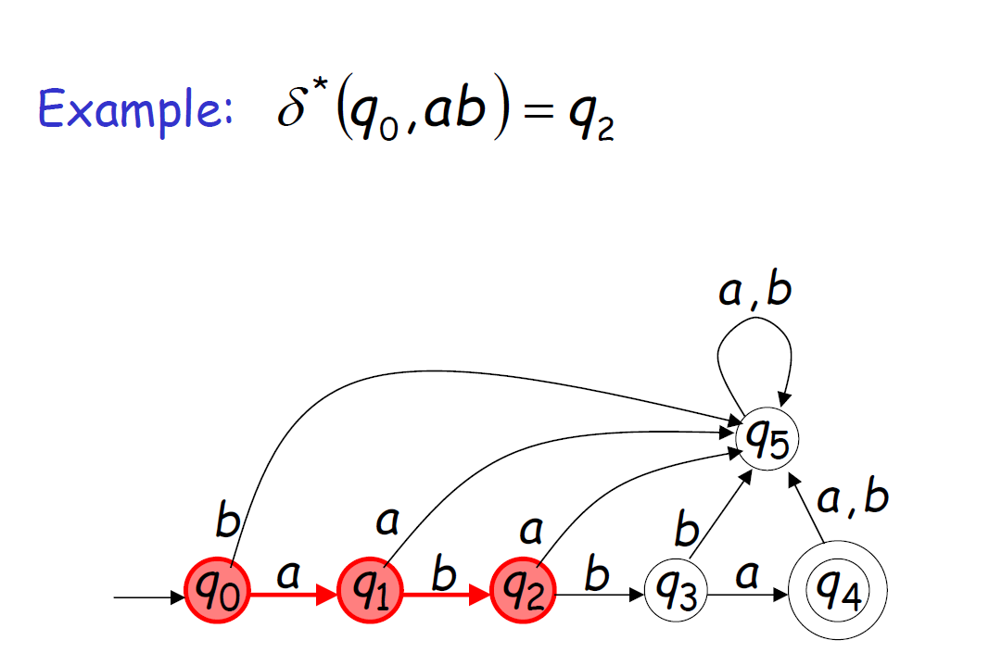
DFA – Extended Transition Function

Slide 4
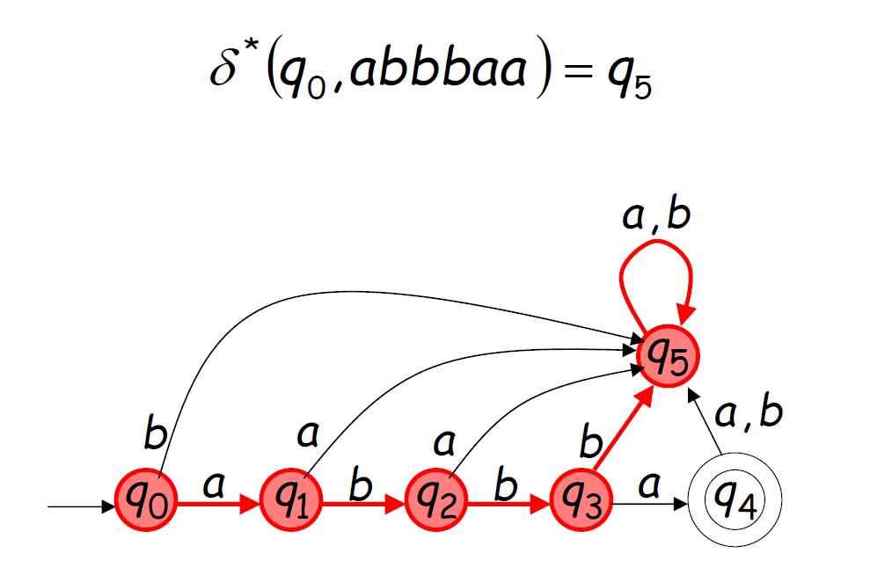
DFA – Extended Transition Function

Slide 5
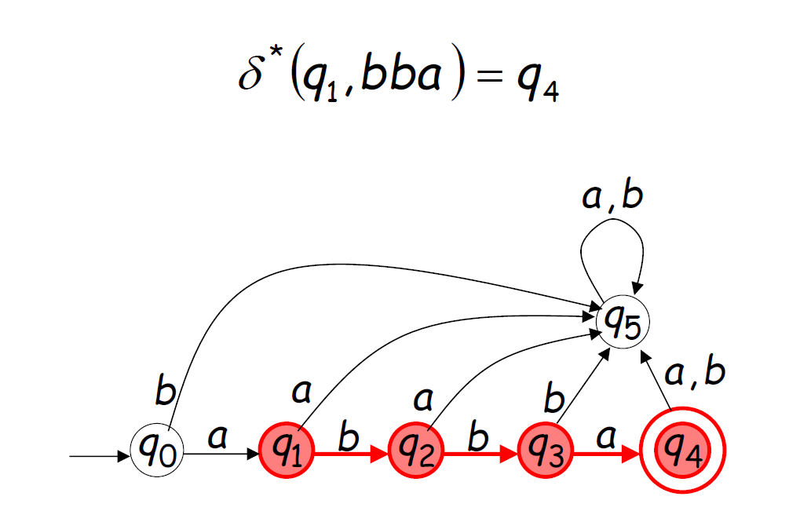
Extended Transition Function need not have starting state as input

Slide 6
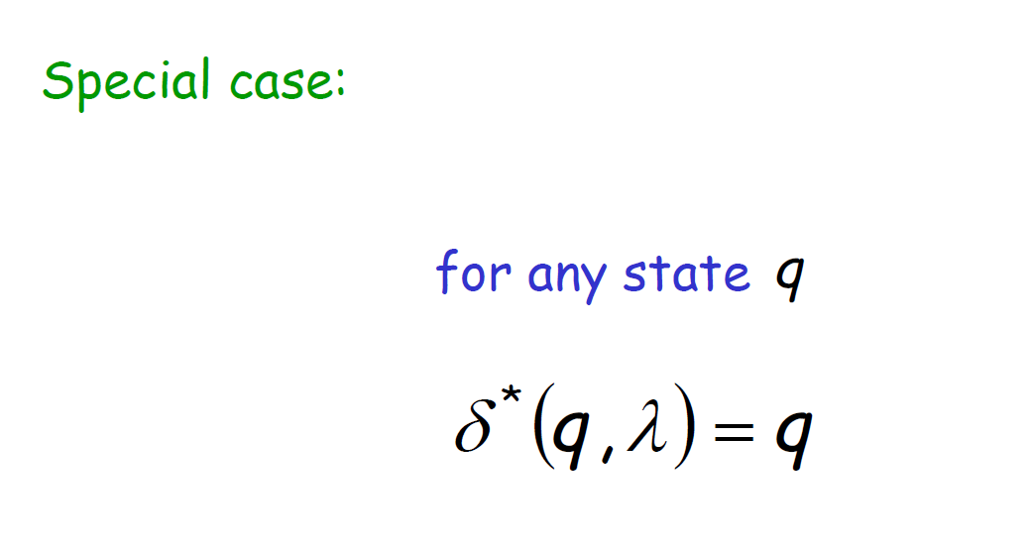
Here ʎ/ε is used to represent input symbol.

Slide 7
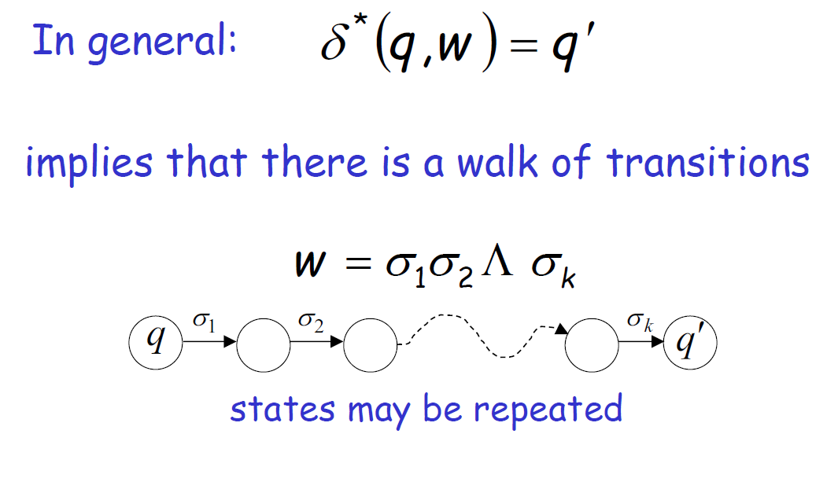

Slide 8
Language Accepted by DFA
Language accepted by DFA M is represented as L(M).
L(M) contains set of all strings accepted by the automata M.
In other words M recognizes L(M).

Slide 9
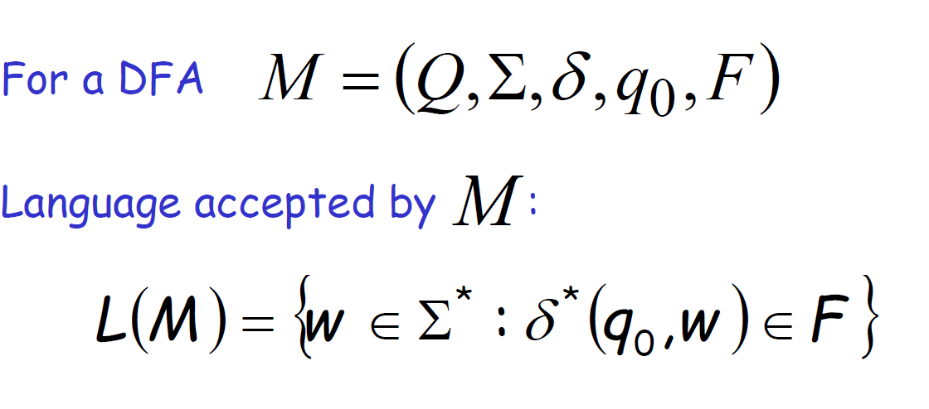
Language Accepted by DFA is set of all strings ‘w’, when fed as input to DFA from starting state will lead to any one of the accepting states.

Slide 10
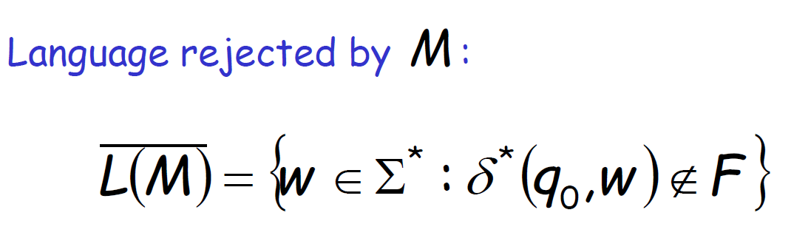
A non accepting string ‘w’ will not end up in accepting states of the DFA

Slide 11
Extended Transition Function...
A transition function that describes what happens when we start from any state and follow a sequence of inputs.
δ-Normal Transition Function.
δ*-Extended Transition Function.(in book it is.....?????)
For a string of length 1 is δ*(q, a) = δ(q, a).

Slide 12
We are trying to prove δ* using induction on the length of the input string
Basic:
δ*(q,ε)=q
Induction:
We consider a string ‘w’ =x.a
– x is a string except the last symbol in the string.
- a is the last symbol in the string.
Consider the string “Tamil” as w
Then ‘x’=Tami
And ‘a’=l

Slide 13
We are trying to prove δ* using induction on the lenght of the input string
δ*(q,w)= δ (δ*(q,x),a)
To compute δ*(q,w) first compute δ*(q,x)
i.e δ*(q,x) =p
then we are in the state ‘p’ after reading ‘x’ starting from the state ‘q’
The we compute δ(p,a) to compute δ*(q,x)
Hence
δ*(q,w)= δ (δ*(q,x),a)

Slide 14
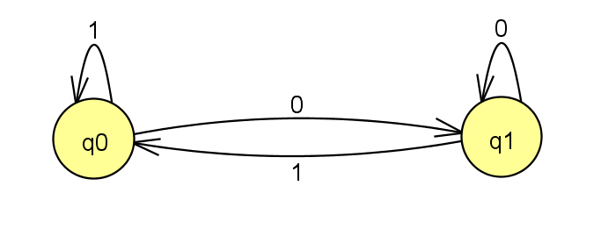
DFA and Transition Table
δ | 0 | 1
q0 | q1 | q0
q1 | q1 | q0

Slide 15
Let us consider the string “1110”
1.δ*(q0,ε)= q0
2. δ*(q0,1)= δ (δ*(q0,ε),1) =q0
3. δ*(q0,11)= δ (δ*(q0,1),1)=q0
4. δ*(q0,111)=δ (δ*(q0,11),1)=q0
5. δ*(q0,1110) = δ (δ*(q0,111),1)=q1
INPUT IS OVER
WHAT TO DO????
Check whether you are in the accepting state....Here YES
Hence we declare/output the string 1110 is accpeted by the DFA

Slide 16
Let us consider the string “1010”
δ*(q₀,ε)=q₀
δ*(q₀,1)= δ(δ*(q₀,ε),1)= δ(q₀,1)=q₀
δ*(q₀,10)= δ(δ*(q₀,1),0)= δ(q₀,0)= q₁
δ*(q₀,101)= δ(δ*(q₀,10),1)= δ(q₁,1)= q₀
δ*(q₀,1010)= δ(δ*(q₀,101),0)= δ(q₀,0)= q₁
accepted
there are two conditions to check
The automata has scanned all the symbols in the input.
The automata is in the accepting state.
Hence the string 1110 is accepted.

Slide 17
Let us consider the string “1011”
δ*(q₀,ε)=q₀
δ*(q₀,1)= δ(δ*(q₀,ε),1)= δ(q₀,1)=q₀
δ*(q₀,10)= δ(δ*(q₀,1),0)= δ(q₀,0)= q₁
δ*(q₀,101)= δ(δ*(q₀,10),1)= δ(q₁,1)= q₀
δ*(q₀,1011)= δ(δ*(q₀,101),1)= δ(q₀,1)= q₀
Rejected

Slide 18
A point to note
Though we say an extended transition function can trace transition from any state, ALL RECOGNITIONS SHOULD START WITH STARTING STATE ONLY.
The extended transition function starting with any state is used for representational purpose only.
Here we have to assume that the phrase “Any state” can refer to starting state also.

Slide 19
Thank You

